Slide 1
Panoramic Image Stitching
Illinois Institute of Technology
CS 512 - Computer Vision
Fall-2018
Arpit Hasmukhbhai Patel(A20424085)
Parthkumar J Patel(A20416508)

Slide 2
Outline
Introduction
Proposed Solution
Implementation Details
Result

Slide 3
Introduction
Image Stitching involves two or more images stitching together into one high resolution image
Image Stitching has main 2 techniques :
Direct Technique
Feature Based Technique
Direct techniques compare all the pixel intensities of the input images with each other.
Feature Based Technique find association between the images through distinct features extracted from the input images.

Slide 4
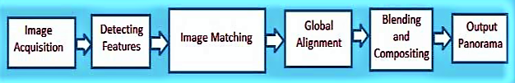
Proposed Solution
Here is how image will processed to get a panoramic image in feature based techniques

Slide 5
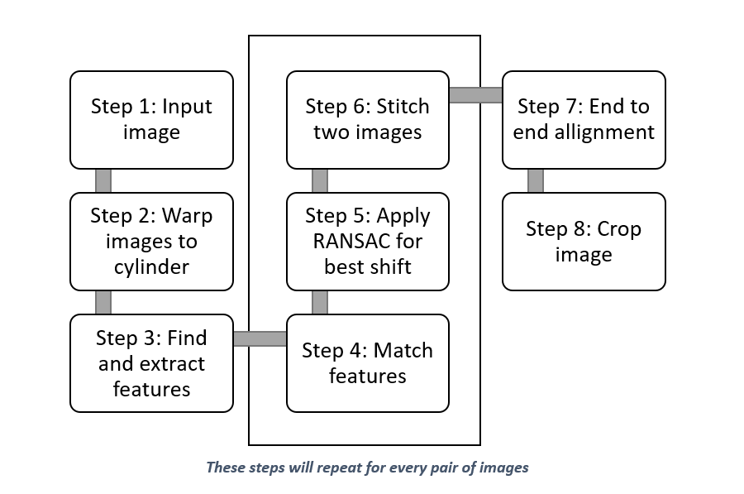
Implementation Details

Slide 6
Implementation Details
Step 1: Input Image
We read images from a path given by user and take a text file that contain focal length of images.
Step 2: Warp Images to Cylinder
We are using Cylindrical Warping. In cylindrical warping every image is represented as if the coordinate system was cylindrical and the image was plotted on the curved surface of the cylinder.
Step 3: Find and Extract Features
We apply Harris Corner detection algorithm and generate corner response matrix
Then we extract descriptor from corner response matrix that will give us feature detected from an image

Slide 7
Implementation Details
Step 4: Match Features
We have feature detected from image so we match the pairs of images according to feature between two images.
Step 5: Apply RANSAC for Best Shift
After matching we use RANSAC algorithm that will gives best shift possible for an image
Step 6: Stitch Two Images
We stitch two images together using best shift value.
We cut unnecessary region, add padding when required and blend images together.

Slide 8
Implementation Details
Step 7: End to End Alignment
In end to end alignment we align the panoramic image and remove the y shift. So, we get the better panoramic image.
Step 8: Crop Image
In crop image we detect the black pixel from upper and lower part of the panoramic image.
We remove it so we get real like Panoramic Image.

Slide 9
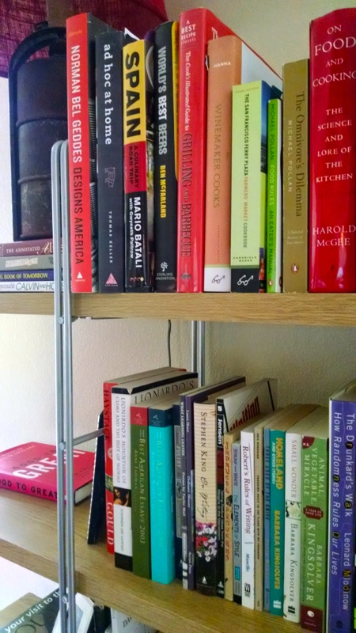
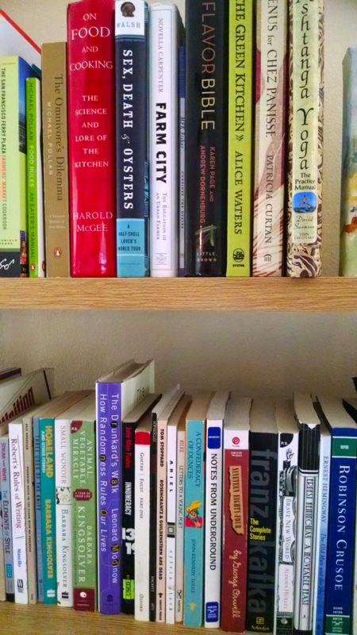
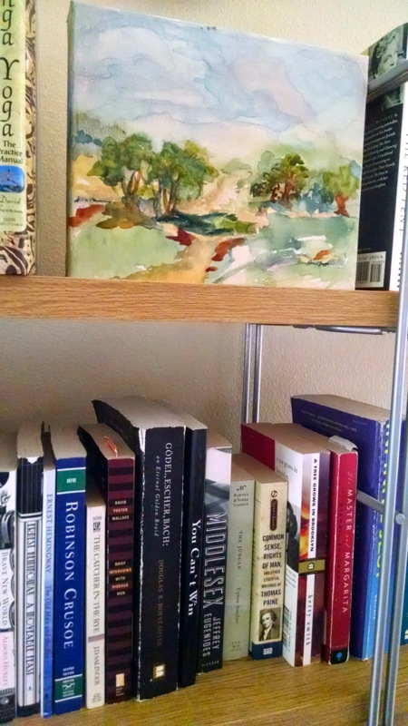
Result
Input Images

Slide 10
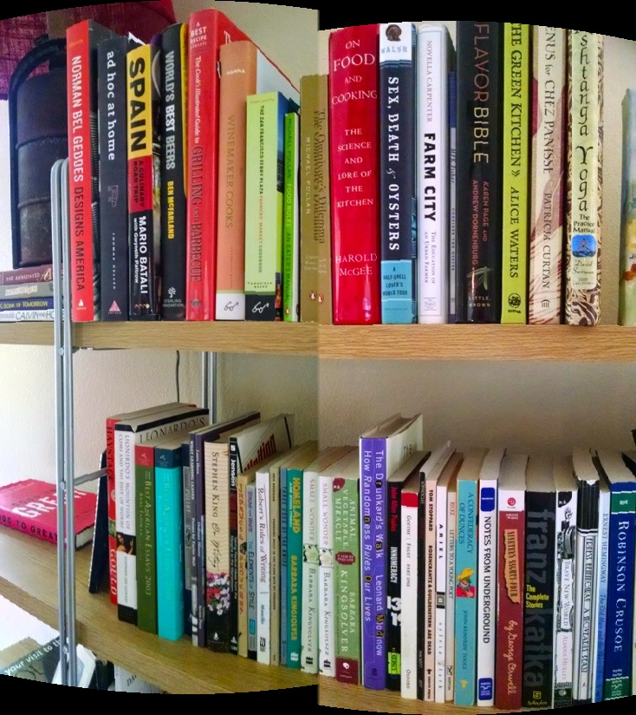
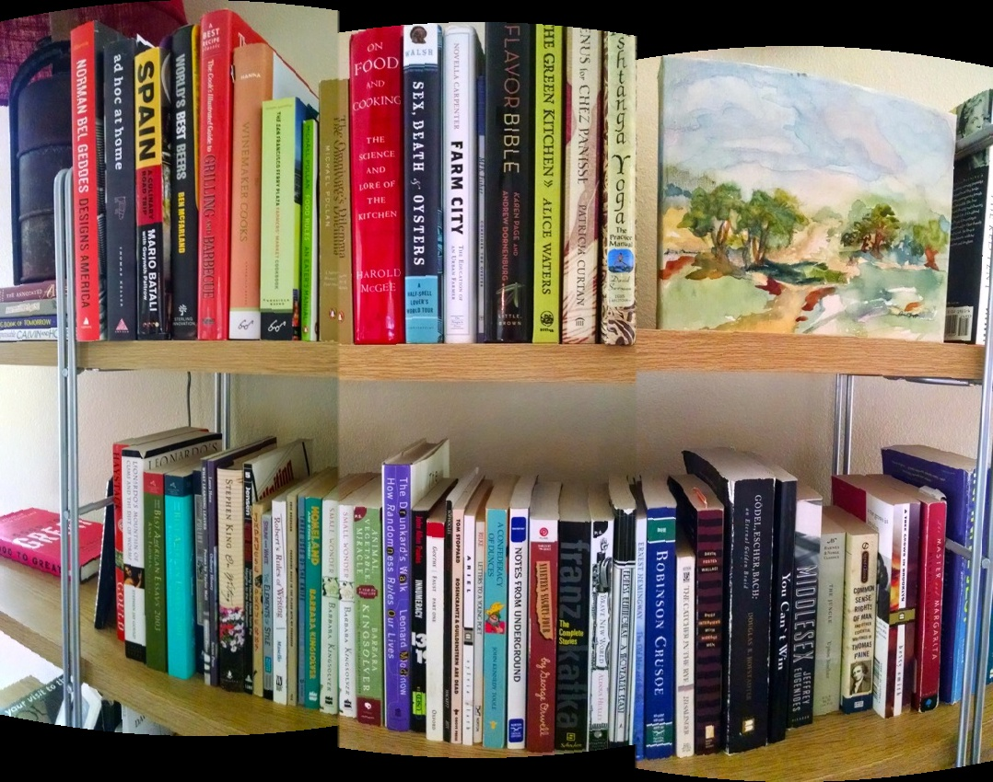
Result
Stitched Images

Slide 11
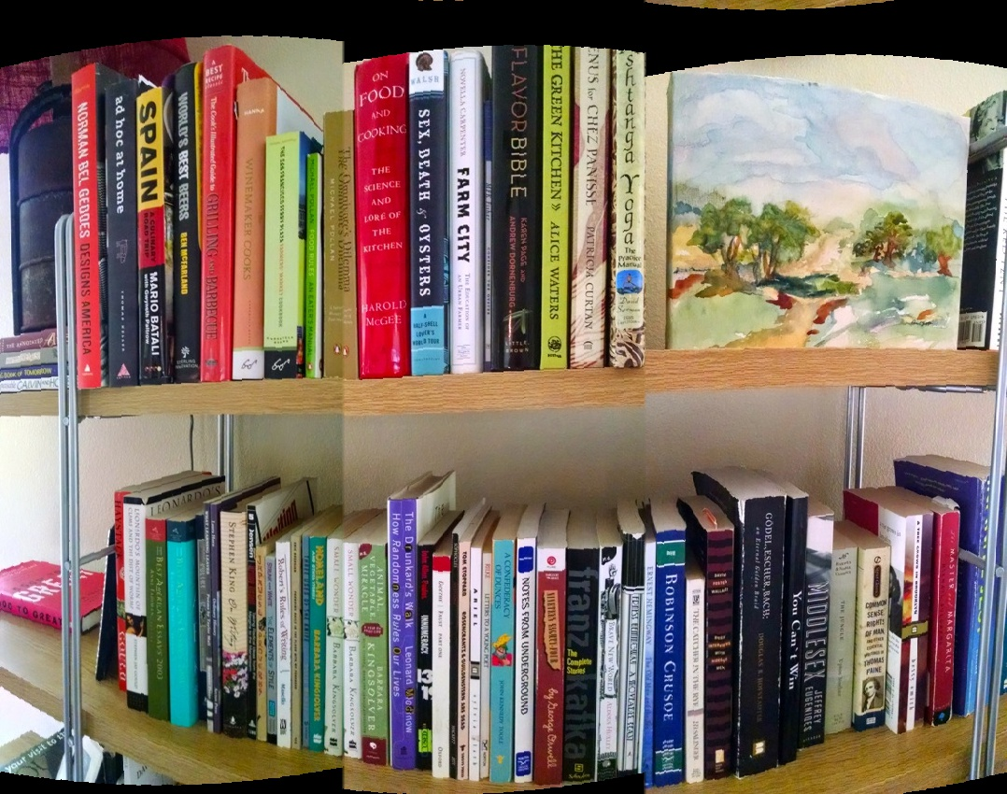
Result
Aligned Image

Slide 12
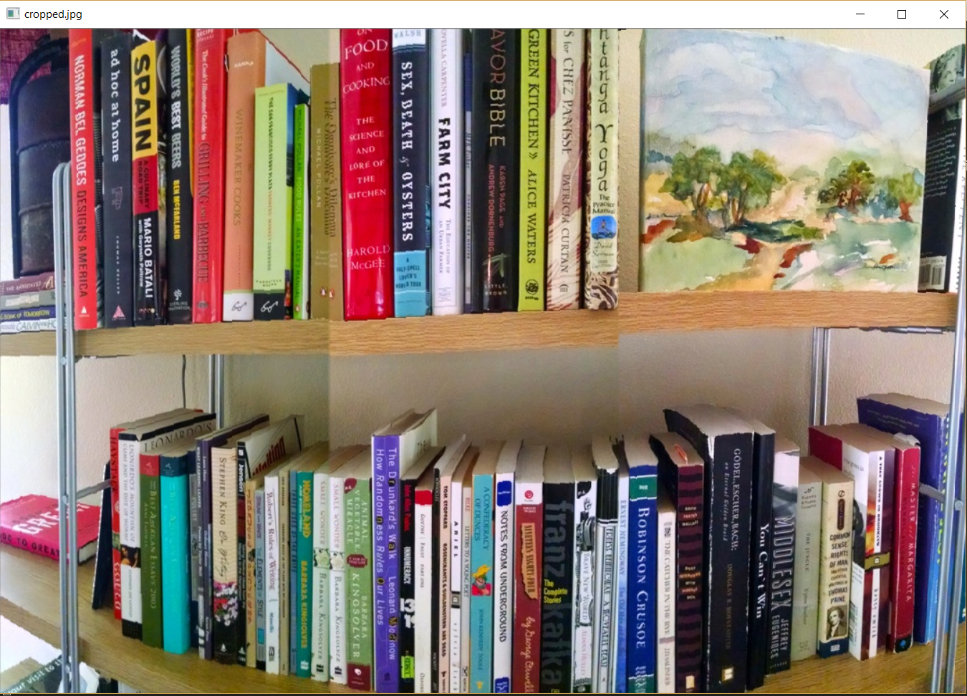
Result
Cropped Final Image

Slide 13
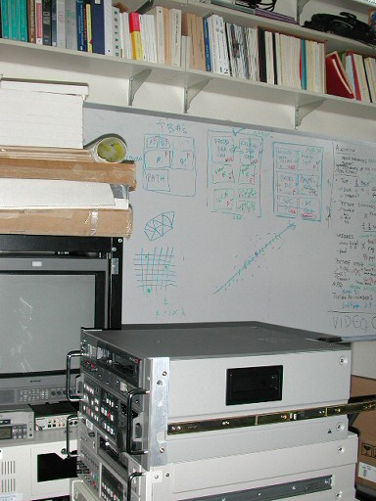
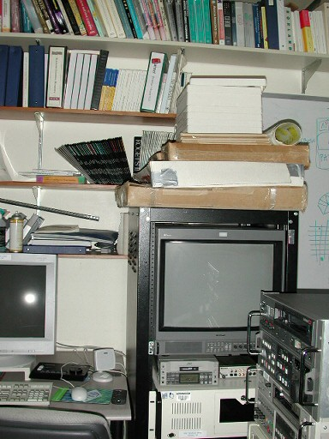
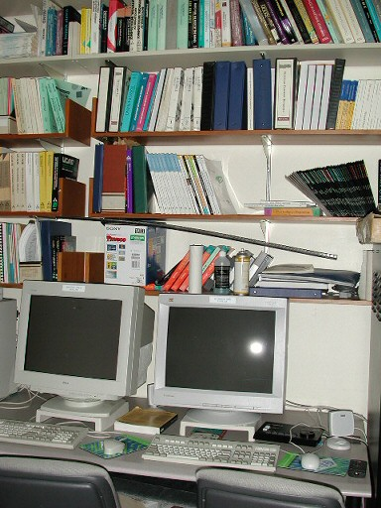
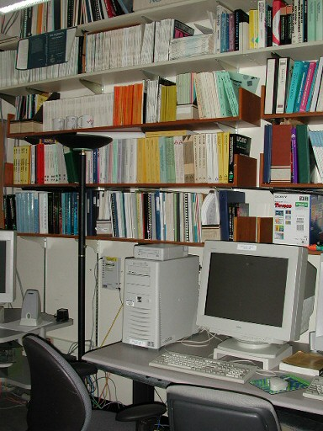
Result
Input Images

Slide 14
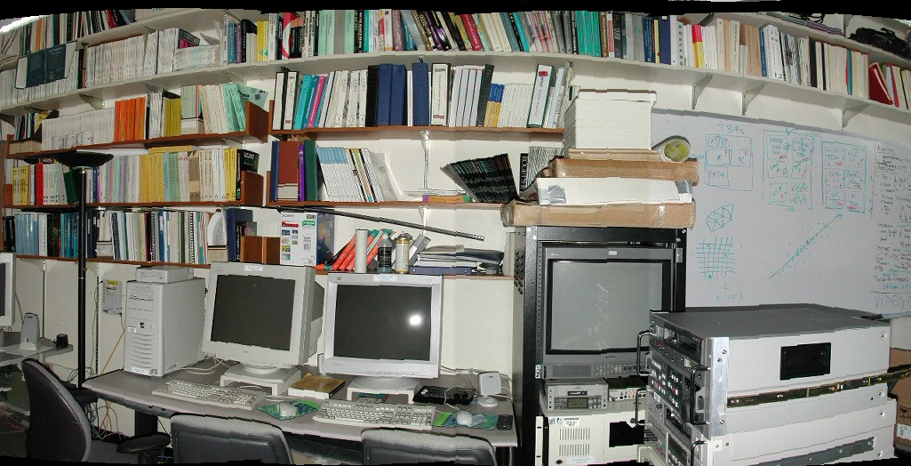
Result
Aligned Image

Slide 15
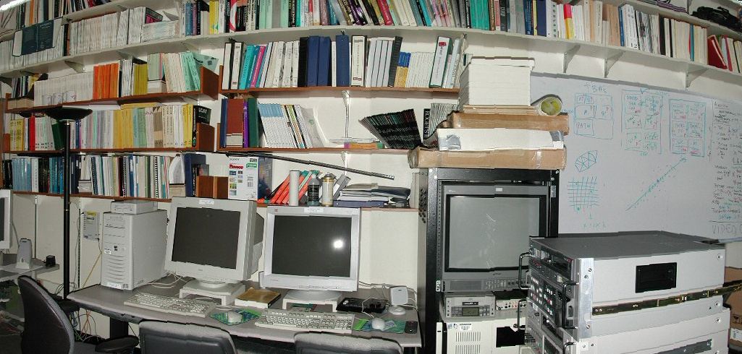
Result
Cropped Final Image

Slide 16
Thank you

